Slide 1


Noida Institute of Engineering and Technology, Greater Noida
POST RELATIONAL DATABASE SYSTEM
Unit 4
Advance DBMS
Course Details (B Tech 6th Sem)
Faculty Name: Mr. Harshit Singh
Assistant Professor
(AIML) Dept.

Slide 2


Faculty Profile
Noida Institute of Engineering and Technology, Greater Noida
Name: Mr. Harshit Singh
Designation: Assistant Professor, AIML Dept.
Qualification:
COURSE | BOARD/UNIVERSITY
M.Tech | AKTU, Lucknow
B.Tech | AKTU, Lucknow

Slide 3
Content
Advanced Data Types
Time in databases
Object-Oriented Database
Spatial and Geographic databases
Multimedia Databases
Deductive database
Temporal database
Constraint in database
Database and XML
New database applications and architectures
Data warehousing
Multimedia
Mobility
Document-oriented databases

Slide 4
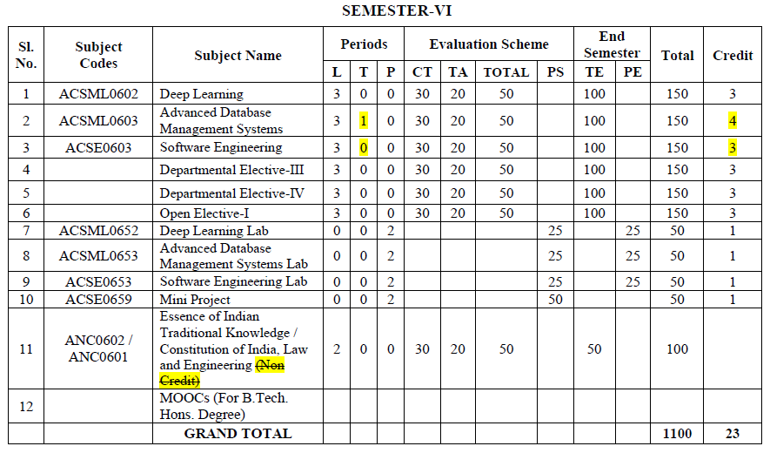
Evaluation Scheme

Slide 5
Syllabus
Advanced Data Types: Time in databases, Object-Oriented Database, Spatial and Geographic databases, Multimedia Databases, Deductive database, Temporal database, Constraint in database, Database and XML.
New database applications and architectures: Data warehousing, Multimedia, Mobility, Document-oriented databases.
n distributed databases Implications for cloud storage.

Slide 6
Branch wise Application
There are various application of Advance DBMS in different fields like:
Railway Reservation System
Library Management System
Banking
Universities and colleges
Credit card transactions etc.

Slide 7
Course Objective
This course provides an introduction to the advanced database management system.
The course introduces both theoretical (knowledge-based) and practical approaches, illustrate the use of advanced database and tools in a variety of application areas, as well as provide insight into many open research problems.

Slide 8
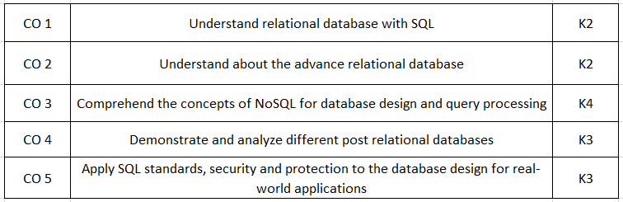
Course Outcomes(COs)

Slide 9

Program Outcomes (POs)
Engineering Graduates will be able to:
1. Engineering knowledge: Apply the knowledge of mathematics, science, engineering fundamentals, and an engineering specialization to the solution of complex engineering problems.
2. Problem analysis: Identify, formulate, review research literature, and analyze complex engineering problems reaching substantiated conclusions using first principles of mathematics, natural sciences, and engineering sciences.
3. Design/development of solutions: Design solutions for complex engineering problems and design system components or processes that meet the specified needs with appropriate consideration for the public health and safety, and the cultural, societal, and environmental considerations.
4. Conduct investigations of complex problems: Use research-based knowledge and research methods including design of experiments, analysis and interpretation of data, and synthesis of the information to provide valid conclusions.

Slide 10
Program Outcomes (POs)
Conti…
5. Modern tool usage: Create, select, and apply appropriate techniques, resources, and modern engineering and IT tools including prediction and modeling to complex engineering activities with an understanding of the limitations.
6. The engineer and society: Apply reasoning informed by the contextual knowledge to assess societal, health, safety, legal and cultural issues and the consequent responsibilities relevant to the professional engineering practice.
7. Environment and sustainability: Understand the impact of the professional engineering solutions in societal and environmental contexts, and demonstrate the knowledge of, and need for sustainable development.
8. Ethics: Apply ethical principles and commit to professional ethics and responsibilities and norms of the engineering practice.

Slide 11
Program Outcomes (POs)
Conti…
9. Individual and team work: Function effectively as an individual, and as a member or leader in diverse teams, and in multidisciplinary settings.
10. Communication: Communicate effectively on complex engineering activities with the engineering community and with society at large, such as, being able to comprehend and write effective reports and design documentation, make effective presentations, and give and receive clear instructions.
11. Project management and finance: Demonstrate knowledge and understanding of the engineering and management principles and apply these to one’s own work, as a member and leader in a team, to manage projects and in multidisciplinary environments.
12. Life-long learning: Recognize the need for, and have the preparation and ability to engage in independent and life-long learning in the broadest context of technological change.

Slide 12

COs and POs Mapping
 | PO1 | PO2 | PO3 | PO4 | PO5 | PO6 | PO7 | PO8 | PO9 | PO10 | PO11 | PO12
 | 2 | 2 | 3 | 3 | 3 | 2 | 3 | 2 | 2 | 2 | 2 | 3
KCS501.2 | 3 | 3 | 3 | 2 | 2 | 2 | 2 | 2 | 2 | 2 | 2 | 3
KCS501.3 | 2 | 3 | 3 | 3 | 3 | 2 | 2 | 2 | 2 | 2 | 2 | 2
KCS501.4 | 2 | 3 | 2 | 2 | 2 | 2 | 2 | 2 | 2 | 3 | 2 | 2
KCS501.5 | 2 | 3 | 2 | 2 | 2 | 3 | 2 | 2 | 3 | 2 | 2 | 2
AVG | 2.20 | 2.80 | 2.60 | 2.40 | 2.40 | 2.20 | 2.20 | 2.00 | 2.20 | 2.20 | 2.00 | 2.40

Slide 13
Program Specific Outcomes (PSOs)
On successful completion of graduation degree the Computer Science & Engineering graduates will be able to:
PSO1:
Design and develop the Hardware and Software systems.
PSO2:
Understand the interdisciplinary computing techniques and an ability to apply them in the design of advanced computing.
PSO3:
Understand the programming methodology, software development paradigms, design and analysis of Algorithms, Operating Systems, Digital Logic Design, Theory of Computation, Discrete Mathematics, Compiler Design, etc.
PSO4:
To integrate & manage the various phases/components of software development projects of society.

Slide 14
COs and PSOs Mapping
 | Program Specific Outcomes
 | PSO1 | PSO2 | PSO3 | PSO4
KCS-501.1 | 3 | 1 | 3 | 1
KCS-501.2 | 3 | 1 | 3 | 1
KCS-501.3 | 3 | 1 | 3 | 1
KCS-501.4 | 3 | 1 | 3 | 1
KCS-501.5 | 3 | 1 | 3 | 1
AVG | 3.00 | 1.00 | 3.00 | 1.00

Slide 15
Program Educational Objectives (PEOs)
PEO1:
Able to apply sound knowledge in the field of information technology to fulfill the needs of IT industry.
PEO2:
Able to design innovative and interdisciplinary systems through latest digital technologies.
PEO3:
Able to inculcate professional ethics, team work and leadership for serving the society.
PEO4:
Able to inculcate lifelong learning in the field of computing for successful career in organizations and R&D sectors.

Slide 16
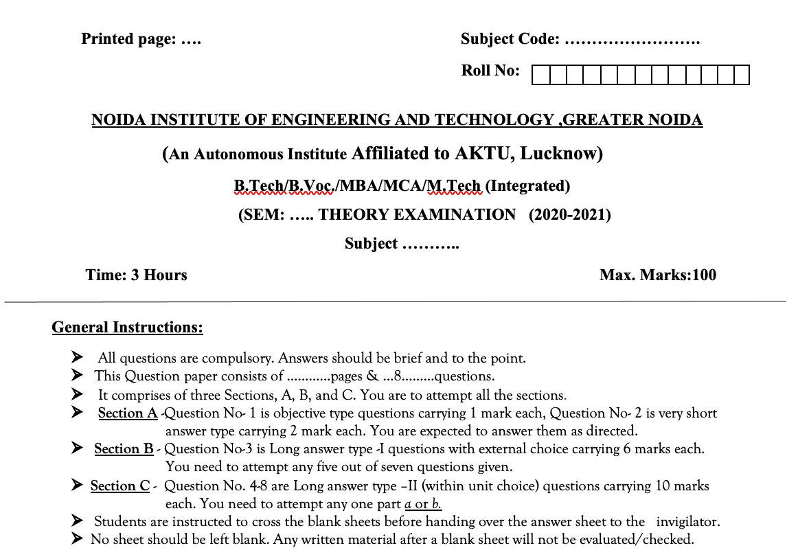

Question Paper Template

Slide 17
Question Paper Template
 |  | SECTION – A |  | CO
 | Attempt all parts- |  | [10×1=10]
 | 1-a. | Question- | (1)
 | 1-b. | Question- | (1)
 | 1-c. | Question- | (1)
 | 1-d. | Question- | (1)
 | 1-e. | Question- | (1)
 | 1-f. | Question- | (1)
 | 1-g. | Question- | (1)
 | 1-h. | Question- | (1)
 | 1-i. | Question- | (1)
 | 1-j. | Question- | (1)
2. | Attempt all parts- |  | [5×2=10] | CO
 | 2-a. | Question- | (2)
 | 2-b. | Question- | (2)
 | 2-c. | Question- | (2)
 | 2-d. | Question- | (2)
 | 2-e. | Question- | (2)
SECTION – B |  |  |  | CO
3. | Answer any five of the following- |  | [5×6=30]
 | 3-a. | Question- | (6)
 | 3-b. | Question- | (6)
 | 3-c. | Question- | (6)
 | 3-d. | Question- | (6)
 | 3-e. | Question- | (6)
 | 3-f. | Question- | (6)
 | 3-g. | Question- | (6)
SECTION – C |  |  |  | CO
4 | Answer any one of the following- |  | [5×10=50]
 | 4-a. | Question- | (10)
 | 4-b. | Question- | (10)
5. | Answer any one of the following-
 | 5-a. | Question- | (10)
 | 5-b. | Question- | (10)
6. | Answer any one of the following-
 | 6-a. | Question- | (10)
 | 6-b. | Question- | (10)
7. | Answer any one of the following-
 | 7-a. | Question- | (10)
 | 7-b. | Question- | (10)
8. | Answer any one of the following-
 | 8-a. | Question- | (10)
 | 8-b. | Question- | (10)

Slide 18
Prerequisite and Recap
The student should have knowledge of relational database management system (RDBMS) and SQL.
Having knowledge of basic mathematics like - SUM, DIFFERENCE, AVERAGE, MEAN, MEDIAN, MODE, etc will definitely be a plus point.
Having knowledge on Set Theory will help.
The proper understanding of data structures (B and B+ trees) will help you to understand the DBMS quickly.

Slide 19
Unit Objective
Students will be able to learn various Distributed Relational Database Model Concepts, constraints.
Introduction on Homogeneous and heterogeneous databases, overview of distributed transactions, Database System Catalogs, learning about Data replication. Differentiate between Synchronous and Asynchronous replication.
Introduction of Two-Phase Commit protocol and its weaknesses and concurrency control in distributed databases Implications for cloud storage.

Slide 20
Object Oriented Database
Are databases that represent data in the form of objects and classes. In object-oriented terminology, an object is a real-world entity, and a class is a collection of objects.
Object-oriented databases follow the fundamental principles of object-oriented programming (OOP).
Object-Oriented Databases (OODB)
The combination of relational model features (concurrency, transaction, and recovery) with object-oriented principles results in an object-oriented database model.

Slide 21
Conti…
Object-Oriented Database Model (OODBM)
The is an alternative implementation to that of a relational model. An object-oriented database is similar in principle to an object-oriented programming language.
An object-oriented database management system is a hybrid application that uses a combination of object-oriented and relational database principles to process data
formula to outline the OODBM => Object-Oriented Programming + Relational Database Features = Object-Oriented Database Model

Slide 22
Building Blocks of Object - Oriented Database
OBJECTS
Real-world entities, such as a specific task in a to-do list: “take the garbage out”.
All objects are assigned a class within data structures for both hierarchy and functional purposes.
ATTRIBUTES AND METHODS
Objects also have properties (attributes) like name, and createdate.
The set of properties, taken together, represents its state.
Objects also have behaviours (known as methods, actions, or functions) that modify or operate on its properties.
CLASSES
Grouping of all objects with the same properties and behaviours.
Not only do classes indicate relationships, such as parent and child, but they also classify objects in terms of function, data types, or other defined data attributes.

Slide 23
Object-oriented programming (OOP) concepts
Abstraction
It is a way of capturing the necessary information to perform desired functionality while excluding un-needed information.
Encapsulation
Not only does abstraction reduce complexity, but it also enables developers to easily select and reuse important functional information quickly which benefits both timelines and budgets.
It refers to the ability of each object to maintain a private state within its assigned class. This means that no other object can directly access that object's state and no other class can alter its functions.
The benefit of encapsulation is that it protects the object from unwanted interference and human error..

Slide 24
Conti…
Inheritance
It enables objects to acquire attributes or properties of another object by reusing the existing fields and methods. For example, assume we have a parent class called “car,” a child class called "Chevrolet," and an object called “Camaro”
Using inheritance, we can easily create object “Impala”, by taking the fields and methods from object “Camaro” and then further customizing “Impala” through additional attributes or methods.
Polymorphism
It enables a child class to use class attributes like its parent class, while retaining all its unique methods and attributes.
To use a real-world example, assume that we have a parent class of “vehicle” with a child class “car” and want to determine tax deduction qualifications.

Slide 25

Conti..
Inheritance
Polymorphism
Encapsulation
Integrity
Concurrency
Object-Oriented Programming Principles
Relational Database Features
Figure 1: The Object-Oriented Database Model

Slide 26
Conti…
Where are Object -Oriented Databases used?
OODs are most often used with object-oriented programming languages like Java, Kotlin, C#, Node JS (React), and Swift.
Industries that use OODs are typically those built on an object-oriented language and to boost productivity while working with complex data structures.
One good example of an OOD is online IT training provider CBT Nuggets. CBT Nuggets uses Realm to offer more than 5,000 courses ranging from basic computer skills to complex network management (

Slide 27
Conti…
Abstraction
is a way of capturing the necessary information to perform desired functionality while excluding un-needed information.
Encapsulation
Not only does abstraction reduce complexity, but it also enables developers to easily select and reuse important functional information quickly which benefits both timelines and budgets.
refers to the ability of each object to maintain a private state within its assigned class. This means that no other object can directly access that object's state and no other class can alter its functions.
The benefit of encapsulation is that it protects the object from unwanted interference and human error.

Slide 28
Conti…
Inheritance
Enables objects to acquire some of the attributes or properties of another object. For example, parent class called "car," a child class called "Chevrolet," and an object called "Camaro."
Using inheritance, create object "Impala," by taking the fields and methods from object "Camaro" and then further customizing "Impala" through additional attributes or methods. Inheritance represents significant time savings while helping to reduce errors in object creation.
Polymorphism
enables a child class to use class attributes like its parent class, while retaining all of its unique methods and attributes. To use a real-world example, assume that we have a parent class of "vehicle" with a child class "car" and want to determine tax deduction qualifications.
User defined data may identify which vehicles qualify for tax deductions, but those are simply attributes within the data structure of a class.

Slide 29
Difference Between Relational Database and Object-oriented Database
Sr. No. | Key | RDBMS | OODBMS
1 | Definition | RDBMS stands for Relational Database Management System. | OODBMS stands for Object Oriented DataBase Management System.
2 | Data Management | Data is stored as entities defined in tabular format. | Data is stored as objects.
3 | Data Complexity | RDBMS handles simple data. | OODBMS handles large and complex data.
4 | Term | An entity refers to collection of similar items having same definition. | An class refers to group of objects having common relationships, behaviors and properties.
5 | Data Handling | RDBMS handles only data. | OODBMS handles both data and functions operating on that data.
6 | Objective | To keep data independent from application program. | To implement data encapsulation.
7 | Key | A primary key identifies in object in a table uniquely. | Object Id, OID represents an object uniquely in group of objects.

Slide 30
Characteristics of Object-Oriented Databases:
It provide system-generated object identifiers and can be identified easily
It provide the encapsulation, data representation and methods implemented are hidden.
It are extensible and identify new data types and operations performed on them.
It also provide inheritance properties in which an object inherits the other objects.
It have a direct relationship between the real world and databases.

Slide 31
Advantages Of Object-Oriented Databases:
Reusability makes our data faster and maintenance is also easy
Object-oriented models allow real-world data to be modelled more closely.
Object-oriented database mama systems have significant performance improvements over relational database management systems.
Data can be handled very easily and can save easily and retrieve data quickly.

Slide 32
Disadvantage Of Object-Oriented Databases:
Many object-oriented database management systems use locking for concurrency control protocol.
Object-oriented databases don't provide any view mechanisms but provide many advantages like data independence, security, and customization.
Object-oriented databases don't provide any adequate security mechanisms
Object-oriented databases are different and more challenging to learn for non-programmers.

Slide 33
Spatial and Geographic databases
Geographic Data :
Geographic data is simply a collection of information that can describe objects and things with relation to space (Here space stands for position). Often this is done with x, y coordinates or longitudes and latitudes
Spatial Data :
Spatial data is also known as geospatial data or geographic information it is the data or information that identifies the geographic location of features and boundaries on Earth, such as natural or constructed features.

Slide 34
Conti…
Spatial Database
It is a database that is optimized to store and query data that represents objects defined in a geometric space.
Most spatial databases allow representing simple geometric objects such as points, lines, and polygons.
Some spatial databases handle more complex structures such as 3D objects, topological coverage’s and linear networks.

Slide 35
Conti…
Advantage of Spatial database
1..Transactions
2. Security/access control
3. Concurrent users
4. Database replication
5. Reduced program maintenance

Slide 36
Conti…
Disadvantage of Spatial database
1. Complex, difficult to design
2. Initial training for users
3. Suitable hardware
4. Conversion costs
6. Slower than other data structures

Slide 37



Why Spatial Database
Spatial databases incorporate functionality that provides support for databases that keep track of objects in a multidimensional space.
For example, cartographic databases that store maps include two-dimensional spatial descriptions of their objects—from countries and states to rivers, cities, roads, seas, and so on.
Other databases, such as meteorological databases for weather information, are three-dimensional, since temperatures and other meteorological information are related to three- dimensional spatial points.

Slide 38
APPLICATIONS OF SPATIAL DATABASE:
APPLICATIONS OF SPATIAL DATABASE:
Many important applications domains have spatial data and queries.
Some examples follow:
1. Army Field Commander.
2.Insurance Risk Manager.
3.Medical Doctor.

Slide 39
Multimedia Databases
Multimedia Databases:
Collection of interrelated multimedia data that includes text, graphics (sketches, drawings), images, animations, video, audio etc and have vast amounts of multisource multimedia data
Multimedia Database Management System:
The framework that manages different types of multimedia data which can be stored, delivered and utilized in different ways is known as multimedia database management system

Slide 40
Multimedia Databases
Three classes of the multimedia database
Static media
Dynamic media
Dimensional media.

Slide 41
Content Of Multimedia Database Management System
1. Media Data:
2. Media Format Data
The actual data representing an object.
Information such as sampling rate, resolution, encoding scheme etc. about the format of media data after it goes through the acquisition, processing and encoding phase.

Slide 42
Content Of Multimedia Database Management System
3. Media Keyword Data
Keywords description relating to the generation of data. It is also known as content descriptive data. Example: date, time and place of recording.
4. Media Feature Data
Content dependent data such as the distribution of colors, kinds of texture and different shapes present in data.

Slide 43
Applications Of Multimedia Database
1. Repository Applications
2. Presentation Applications
3. Collaborative Work Using Multimedia Information
A Large amount of multimedia data as well as meta-data(Media format date, Media keyword data, Media feature data) that is stored for retrieval purpose, e.g., Repository of satellite images, engineering drawings, radiology scanned pictures.
They involve delivery of multimedia data subject to temporal constraint. Optimal viewing or listening requires DBMS to deliver data at certain rate offering the quality of service above a certain threshold. Here data is processed as it is delivered. Example: Annotating of video and audio data, real-time editing analysis.
It involves executing a complex task by merging drawings, changing notifications. Example: Intelligent healthcare network.

Slide 44
Challenges To Multimedia Databases
1. Modelling
2. Design
Working in this area can improve database versus information retrieval techniques thus, documents constitute a specialized area and deserve special consideration.
He conceptual, logical and physical design of multimedia databases has not yet been addressed fully as performance and tuning issues at each level are far more complex as they consist of a variety of formats like JPEG, GIF, PNG, MPEG which is not easy to convert from one form to another..

Slide 45
Challenges To Multimedia Databases
3. Storage
Storage of multimedia database on any standard disk presents the problem of representation, compression, mapping to device hierarchies, archiving and buffering during input-output operation.
4. Performance
For an application involving video playback or audio-video synchronization, physical limitations dominate. The use of parallel processing may alleviate some problems but such techniques are not yet fully developed.
In DBMS, a ”BLOB”(Binary Large Object) facility allows untyped bitmaps to be stored and retrieved
Apart from this multimedia database consume a lot of processing time as well as bandwidth.

Slide 46
Deductive Database
What is Deduction & Induction
Deductive: towards the consequences
All swans are white.
Jacki is a swan.
Inductive: towards a generalization of observations
Rakesh and Abhishek and John and Jarvis and ... (a// observed swans) are swans.
Rakesh and Abhishek and John and Jarvis and ... (a// observed swans) are white.
Jacki is White
All Swans are White

Slide 47
Deductive Database
Deduction
Human beings have the interesting ability to derive facts from a set of data, even though these facts are not explicitly represented in the data. That is, given appropriate information, humans can deduce new information by applying rules. For example, given a list of people and their parents, we could deduce their grandparents, great-grandparents, and so on, despite the fact that these facts were not explicitly represented in the original data. What here is done is to use a rule: “the parent of a parentis a grandparent (and so on).

Slide 48
Deductive Database
Conventional Databases
In very general terms, a conventional database consists of a collection of facts. Using some form of query language, these facts may be accessed and manipulated as required. However, facts must be explicitly stored in the database for them to be of any use.
If a fact is not explicitly represented in the database, then as far as the database is concerned, that fact effectively does not exist.

Slide 49
Deductive Database
Conventional Databases
To clarify this idea of implicit data representation, consider the following example.
Suppose we have a conventional database that contains the two facts:
“John is Bill’s father.” “Bill is Derek’s father.”
Now most people will quickly realise that John is also Derek’s grandfather (assuming, of course, that the two Bills are the same person).
In other words, this fact is implicit in the two existing facts. However, the fact “John is Derek’s grandfather” is not stored in the database, so as far as the database is concerned, there is no relationship whatsoever between John and Derek.

Slide 50
Deductive Database
Deductive Databases
A deductive database contains not only facts, but also general rules. These rules can be used to deduce new facts that are not explicitly represented in the database; that is, data can be stored implicitly. Now consider the following deductive database:
In addition to the two facts, this database also contains a rule that specifies the grandfather relationship between a pair of entities. The database can prove the statement “John is Derek’s grandfather” by making the following substitution into the rule: x = “John”, y = “Bill” and z = “Derek”.
“John is Bill’s father.” “Bill is Derek’s father.” “IF x is y’s father AND y is z’s father, THEN x is z’s grandfather.”

Slide 51
Deductive Database
Deductive Databases
The effect of rules of this form is to define new relations that are not explicitly represented in the database. These are known as implicit or virtual relations. Explicit relations, like the father relation above, are known as base relations. The set of virtual relations is called the intentional database (IDB), while the set of base relations is called the extensional database (EDB). Deductive database systems are based on first-order logic. First-order logic allows us to express both facts and rules about the facts using the same syntax.

Slide 52
Deductive Database
Deductive Databases
The first-order predicate calculus is one particular language for expressing logical statements. For example, the representation of the database above in first-order logic would be:
father(John, Bill)
(⍱x ⍱y ⍱z)(father(x, y) A father(y, z) — grandfather(x, z)) where A, — and V represent conjunction, implication and the quantifier “for all” respectively.
father(Bill, Derek)

Slide 53

Deductive Database
Deductive Databases
It can be defined as an advanced database augmented with an inference system. Deductive databases have grown out of the desire to combine logic programming with relational databases to construct systems that support a powerful formalism.
The immediate advantage of this is that it can potentially reduce the space needed to store data.
Database
Inference
Deductive Database

Slide 54
Deductive Database
Deductive Databases
In a deductive database system, we typically specify rules through a declarative language—a language in which we specify what to achieve rather than how to achieve it. An inference engine (or deduction mechanism) within the system can deduce new facts from the database by interpreting these rules. Deductive databases have not found widespread adoptions outside academia, but some of their concepts are used in today's relational databases to support the advanced features of more recent SQL standards.

Slide 55
Deductive Database
Prolog / Datalog Notion
The notation used in Prolog/Datalog is based on providing predicates with unique names A predicate has an implicit meaning, which is suggested by the predicate name, and a fixed number of arguments If the arguments are all constant values, the predicate simply states that a certain fact is true If the predicate has variables as arguments, it is either considered as a query or as part of a rule or constraint All constant values in a predicate are either numeric or character strings starting with lowercase letters, whereas variable names always start with an uppercase letter

Slide 56
Deductive Database
Prolog / Datalog Notation
A program is built from basic objects called atomic formulas Atomic formulas are literals of the form p(a,, as, .... a,), where p is a predicate name and n is the number of arguments for predicate p Different predicate symbols can have different number of arguments, and the number of arguments n of predicate p is sometimes called the arity or degree of p The arguments can be either constant values or variable names; Constant values are either numeric or character strings starting with lowercase letters, whereas variable names always start with an uppercase letter

Slide 57
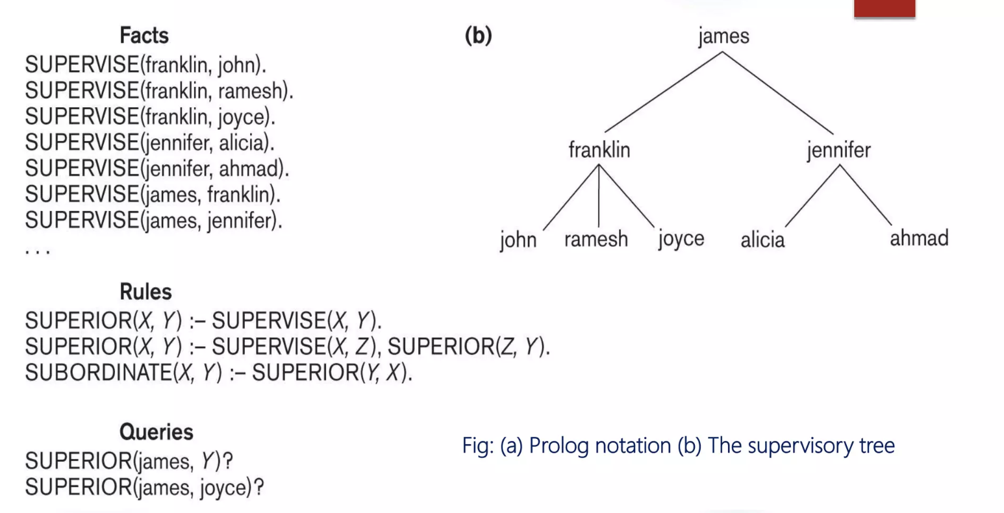
Prolog / Datalog Notation

Slide 58
Important Differences Between Deductive Databases And Logic Programming
Order Sensitivity And Procedurally:
Special Predicates:
Function Symbols:
Tuple-oriented Processing:
In Prolog, program execution depends on the order of rules in the program and on the order of parts of rules; these properties are used by programmers to build efficient programs.
In database languages (like SQL or Datalog), however, program execution is independent of the order of rules and facts.
In Prolog, programmers can directly influence the procedural evaluation of the program with special predicates such as the cut, this has no correspondence in deductive databases.
Logic Programming languages allow function symbols to build up complex symbols. This is not allowed in deductive databases.
Deductive databases use set-oriented processing while logic programming languages concentrate on one tuple at a time.

Slide 59
Temporal Database
Typically, databases model only one state - the current state- of the real world, and do not store information about past states, except perhaps as audit trails.
When the state of the real-world changes, the database gets updated, and information about the old state gets lost.
Applications usually require the knowledge of the information’s evolution, implying the storage of different states of information, including past values and future previews.
For example, a patient database must store information about the medical history of a patient.

Slide 60
Temporal Database
A factory monitoring system may store information about current and past readings of sensors in the factory, for analysis.
This led to the development of researches concerning temporal aspects in information systems.
Databases that store information about states of the real world across time are called temporal databases.
Temporal databases, in the broadest sense, encompass all database applications that require some aspect of time when organizing their information.

Slide 61
Temporal Database
There are many other examples of applications (reservation systems, scientific databases, company database, university database etc.) where some aspect of time is needed to maintain the information in database.
Insurance, where claims and accident histories are required as well as information about the times when insurance policies are in effec
Reservation systems in general (hotel, airline, car rental, train, and so on), where information on the dates and times when reservations are in effect are required.
Scientific databases, where data collected from experiments includes the time when each data is measured; and so on.

Slide 62
Temporal Database
Temporal databases allow the storage and the recovery of all the states assumed by an object during its lifetime, thus recording its evolution with time.
When considering the issue of time in database systems, we must distinguish between time as measured by the system and time as observed in the real world.
The valid time for a fact is the set of time intervals during which the fact is true in the real world
The transaction time for a fact is the time interval during which the fact is current within the database system.

Slide 63
Temporal Database
A temporal database stores data relating to time instances. It offers temporal data types and stores information relating to past, present and future time. Temporal databases could be uni-temporal, bi-temporal or tri-temporal.
The temporal aspects usually include valid time, transaction time or decision time.
Valid time: is the time period during which a fact is true in the real world.
Transaction time: is the time at which a fact was recorded in the database.
Decision time: is the time at which the decision was made about the fact.

Slide 64
Temporal Database
Uni-temporal
A uni-temporal database has one axis of time, either the validity range or the system time range.

Slide 65
Temporal Database
Bi-temporal
A bi-temporal database has two axes of time:
valid time transaction time or decision time

Slide 66
Temporal Database
Tri-temporal
A tri-temporal database has three axes of time:
This approach introduces additional complexities.
Valid time Transaction time Decision time
NOTE: Temporal databases are in contrast to current databases (not to be confused with currently available databases), which store only facts which are believed to be true at the current time.

Slide 67
Constraint In Database
Database constraints are a key feature of database management systems. They ensure that rules defined at data model creation are enforced when the data is manipulated ( inserted, updated, or deleted) in a database.
Constraints are the rules enforced on the data columns of a table. These are used to limit the type of data that can go into a table. This ensures the accuracy and reliability of the data in the database.
Constraints could be either on a column level or a table level. The column level constraints are applied only to one column, whereas the table level constraints are applied to the whole table.

Slide 68
Constraint In Database
Constraints are used to specify the rules for the data in a table.
Constraints enforce the limits to the data or type of data that can be inserted /updated or deleted from a table.
The min purpose of the constraints is to maintain the data integrity during an inserted /updated or deleted into a table.

Slide 69
Types of Constraint In Database
NOT NULL
DEFAULT
UNIQUE
KEY
PRIMARY Key
FOREIGN Key
CHECK
Constraint Types
DEFAULT

Slide 70
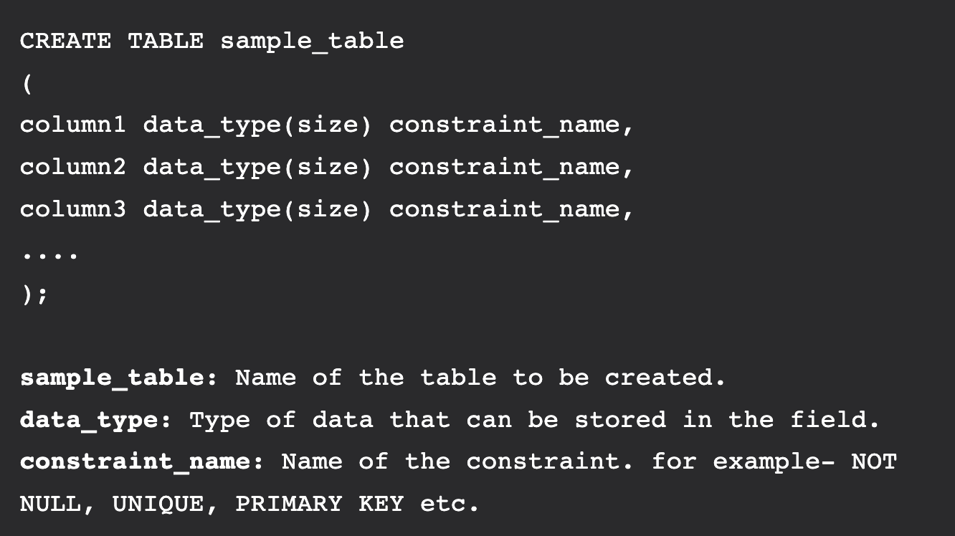
Types of Constraint In Database
How to specify constraints?
We can specify constraints at the time of creating the table using CREATE TABLE statement. We can also specify the constraints after creating a table using ALTER TABLE statement.
Syntax to create constraints using CREATE TABLE statement at the time of creating the table.

Slide 71
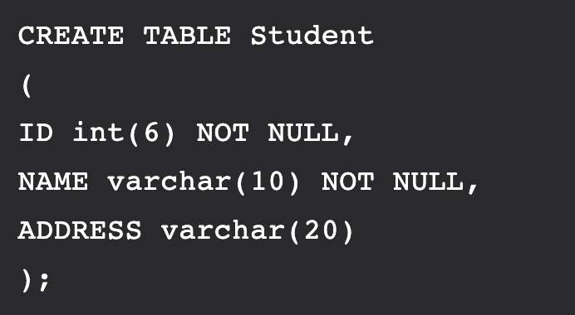
Types of Constraint In Database
NOT NULL
Its field will never accept null value. That is, it will be not allowed to insert a new row in the table without specifying any value to this field.
User will be bound to specify values for these two fields every time he/she wish to insert a new row.
Example, creates a table Student with fields ID and NAME as NOT NULL.

Slide 72
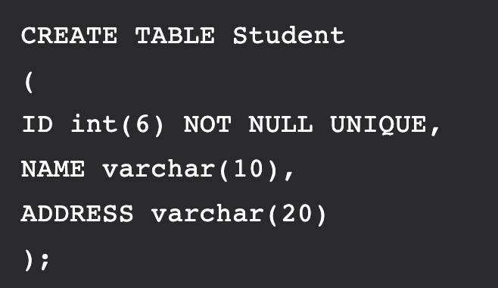
Types of Constraint In Database
UNIQUE
Uniquely identify each row in the table. i.e. for a particular column, all the rows should have unique values.
More than one UNIQUE columns in a table is allowed.
It enforces a column or set of columns to have unique values. If a column has a UNIQUE constraint, it means that column cannot have duplicate values in a table.
Example, creates a table Student with fields ID and NAME as UNIQUE, i.e, no two students can have the same ID

Slide 73
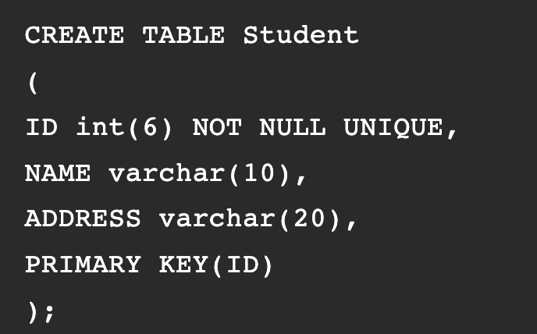
Types of Constraint In Database
PRIMARY KEY
Uniquely identifies each row in the table.
Field will not be able to contain NULL values as well as all the rows should have unique values for this field.
combination of NOT NULL and UNIQUE constraintsthis field.
A table can have only one field as primary key
Example, create a table named Student and specifies the field ID as primary key.

Slide 74
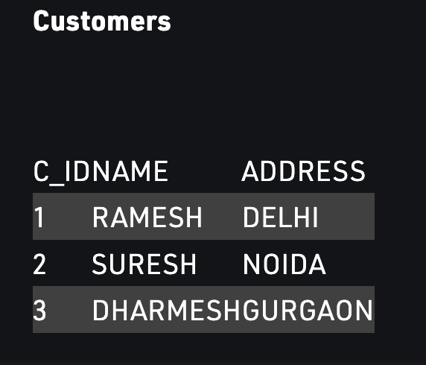
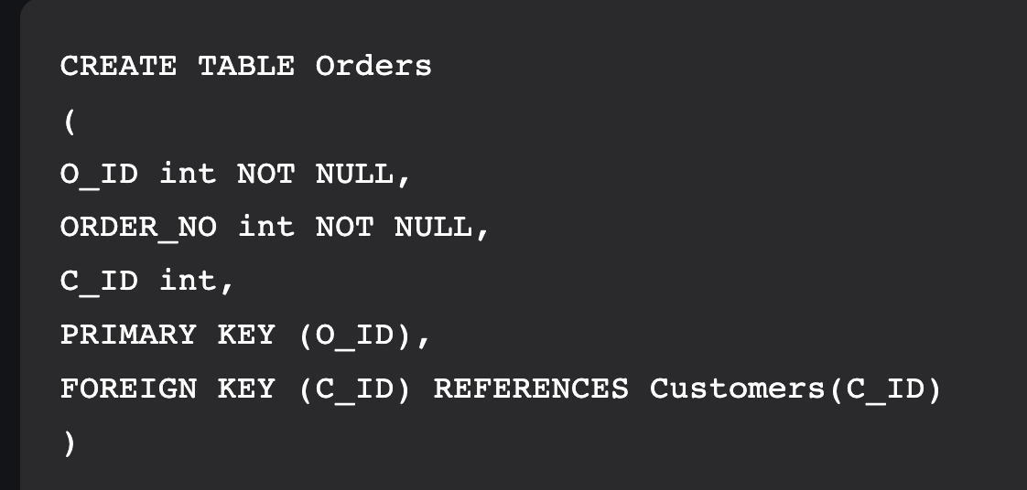
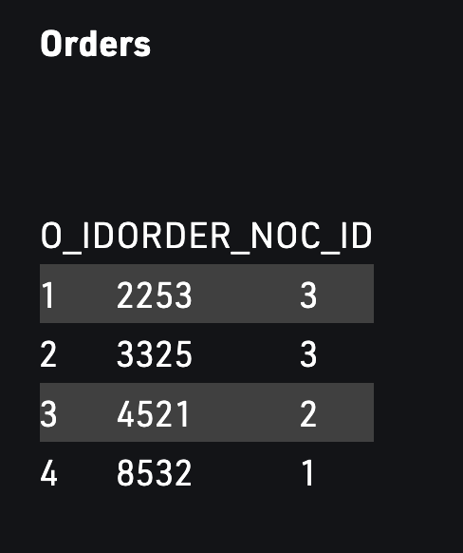
Types of Constraint In Database
FOREIGN KEY
Uniquely identifies each row of another table.
Field points to primary key of another table.
Creates a kind of link between the tables.
A table can have only one field as primary key
Field C_ID in Orders table is the primary key in Customers table, i.e. it uniquely identifies each row in the Customers table. Therefore, it is a Foreign Key in Orders table.

Slide 75
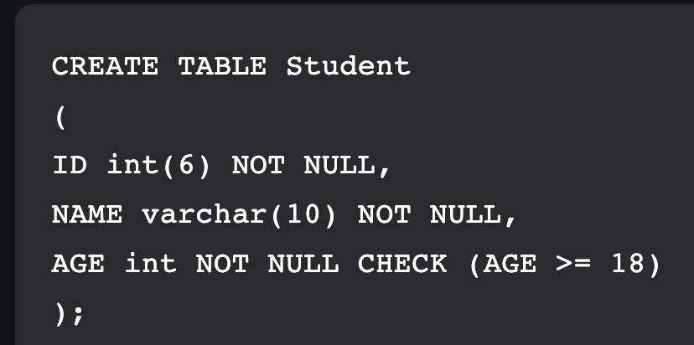
Types of Constraint In Database
CHECK
It is used to restrict the value of a column between a range. It performs check on the values, before storing them into the database. Its like condition checking before saving data into a column. When this constraint is being set on a column, it ensures that the specified column must have the value falling in the specified range.
User will not be allowed to enter any record in the table with AGE < 18.
creates a table Student and specifies the condition for the field AGE as (AGE >= 18 ).

Slide 76
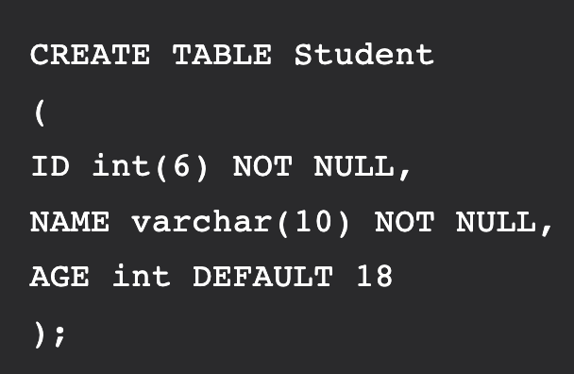
Types of Constraint In Database
DEFAULT
Used to provide a default value for the fields.
If at the time of entering new records in the table if the user does not specify any value for these fields, then the default value will be assigned to them
Create a table named Student and specify the default value for the field AGE as 18.

Slide 77
XML and Database
XML stands for eXtensible Markup Language Widely used on the World Wide Web as a means of communication between different types of web components
It is a W3C (World Wide Web Consortium) standard
An XML database is a data persistence software system that allows data to be specified, and sometimes stored, in XML format.
This data can be queried, transformed, exported and returned to a calling system.
XML databases are a flavor of document-oriented databases which are in turn a category of NoSQL database.

Slide 78
XML and Database
There are number of reasons to directly specify data in XML or other document formats such as JSON. For XML, they include
An enterprise may have a lot of XML in an existing standard format
Data may need to be exposed or ingested as XML, so using another format such as relational forces double - modelling of the data
XML is very well suited to sparse data, deeply nested data and mixed content (such as text with embedded markup tags)
XML is human readable whereas relational tables require expertise to access
Metadata is often available as XML
Semantic web data is available as RDF/XML
Provides a solution for Object-relational impedance mismatch

Slide 79
XML and Database
There are number of reasons to directly specify data in XML or other document formats such as JSON. For XML, they include
An enterprise may have a lot of XML in an existing standard format
Data may need to be exposed or ingested as XML, so using another format such as relational forces double - modelling of the data
XML is very well suited to sparse data, deeply nested data and mixed content (such as text with embedded markup tags)
XML is human readable whereas relational tables require expertise to access
Metadata is often available as XML
Semantic web data is available as RDF/XML
Provides a solution for Object-relational impedance mismatch

Slide 80
XML Characteristics
XML is a markup language, like HTM
XML primarily consists of tags, attributes and data
XML tags are not pre-defined like HTML
XML tags are user-defined
While HTML defines the layout for data, XML describes the data
XML documents need to be well formed
Transporting, Storing and Sharing Data

Slide 81
XML Usage
Examples:
Software Updates
XML Sitemaps
Web-based feeds, such as RSS, jobs, weather reports, stock updates, etc.
Third-party application

Slide 82
XML Vs RDBMS
For XML, Things to
keep
in mind
It is self describing.
it contains not only the data but also the meta data.
We do not really need to know the schema to read from an XML, unlike RDBMS which is wholly dependent on schema.
Data in XML is more of a hierarchical model, so something like A country is divided into states, each state is divided into districts and each districts into talukas.
RBDMS on the other hand specifies relationship in a more normalized form, using primary and foreign keys.
E.g.: A country has many states, but a state can belong to only one country. A State has many districts, but each district belongs to only one state.
RDBMS is more like different sets of data, related to each other. So you have different seats say-Country, State, City, District all inter related to each other in a way.

Slide 83
ISSUES IN XML
Speed — Data retrieval could be relatively slow due to verbose nature
Security — Data could be interrupted duringtransmission
Scope — Limited scope in comparison to relational Databases

Slide 84
XML Vs RDBMS
Advantageous to use XML over RDBMS
Volatile Schema- You have data in a table, whose schema might have to keep changing often. Say something like stock prices, where you might not be needing some columns and drop them. Or say change the data type of pricing from float to currency. This is more effective in an XML, where schema modification is far simpler.
Hierarchical Data- Something like a Customer Address, which is inherently hierarchical in nature- Name->Address 1→Address2→City→State→District→Country→Pincode etc, is more suitable in an XML, than in an RBDMS which would need a complex system of relationship between Country, State, District etc. This sort of data is more suitable for XML.
Component-Owner Data- Data that exists within the context of a business object only. For eg, an employee might have multiple phone numbers- home, work, mobile, landline. These numbers by themselves do not have any meaning if the employee no longer is with the organization. Now in case of an RDBMS, say an employee quits an organization or is fired, in order to remove all his associated data, one needs to traverse joins, child tables so that integrity is not compromised. Putting it an XML, would make it easier to remove or update the data.

Slide 85
New Database Applications And Architectures
Database Applications
Data warehousing
Multimedia
Mobility
Document-oriented databases.

Slide 86
New Database Applications And Architectures
Database Architecture
Data Warehousing: It is a repository of data that has been extracted from a variety of sources, including data reported by users, manufacturers, and third-party vendors
Purpose Of Data Warehouse
They store both live and archived data in one location.
This means that the same data is available both as a result of business processes being completed or operations being performed also because it is simply existing data stored in one place.

Slide 87
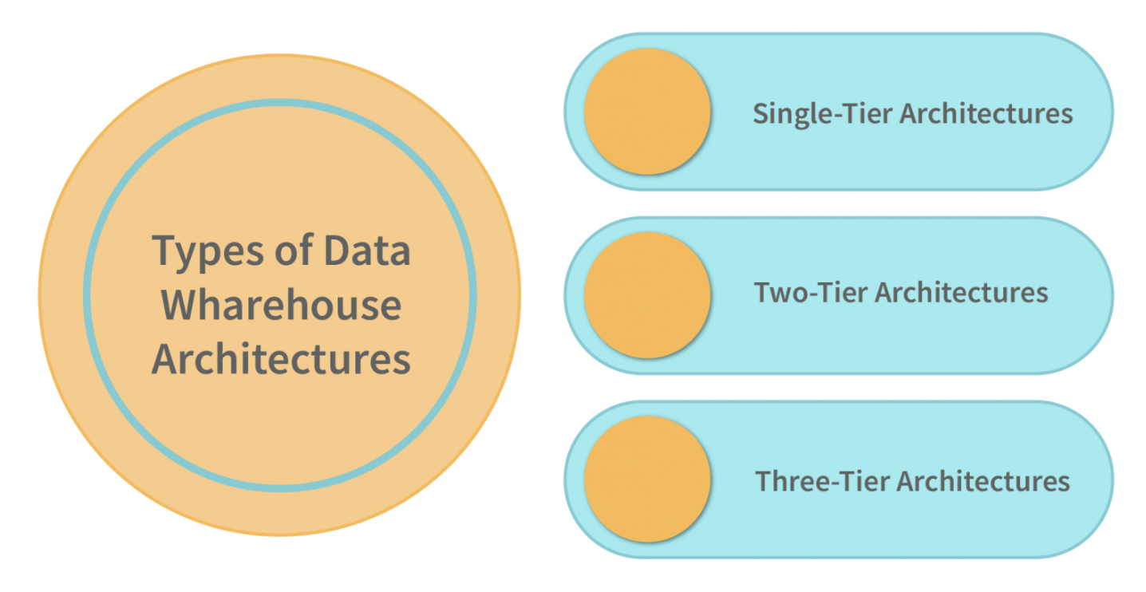
New Database Applications And Architectures

Slide 88
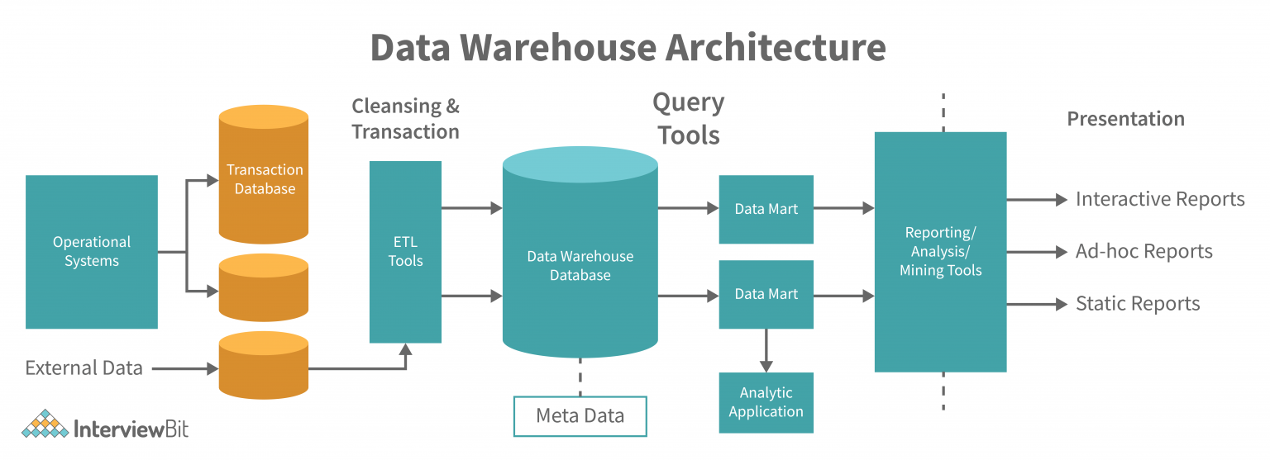

New Database Applications And Architectures
Data Warehouse

Slide 89
New Database Applications And Architectures
Single-tire-Architecture
Not implemented in real-time systems.
They are used for batch and real-time processing.
The data is first transferred to a single-tier architecture where it is converted into a format that is suitable for real-time processing.
After this, the data is transferred to a real-time system.
Single-tier architectures are currently the most preferred way to process operational data.

Slide 90
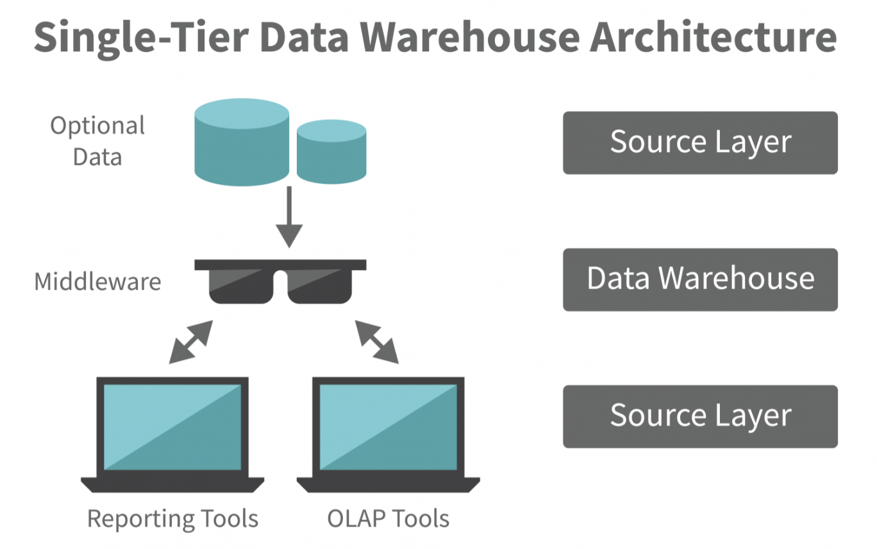
New Database Applications And Architectures
This architecture is known as “single-threaded”

Slide 91
New Database Applications And Architectures
Two-tire-Architecture: Source Layer
Source of the data is critical to the data warehouse’s integrity.
The integrity of the data stored in the data warehouse must be guaranteed.
Data integrity is the degree to which data values in a database record are true or accurate.

Slide 92
New Database Applications And Architectures
Two-tire-Architecture: Data Staging
Data staging is a key process in the ETL process, and one that can significantly reduce the time it takes to extract, transform, and load (ETL) a large data set.
ETL tools can extract data from various storage sources, transform the data with corporate-specific functions, and load the data into a data warehouse.

Slide 93
New Database Applications And Architectures
Two-tire-Architecture: Metadata
Metadata is a critical component of the data warehouse.
It is the information that helps a data warehouse administrator decide which data to delete, which data to retain, and which data to use in future reports.
It is also important to maintain data warehouse consistency.

Slide 94
New Database Applications And Architectures
Two-tire-Architecture: Data profiling
Data profiling is also very important for this level as it helps in validating data integrity and presentation standards.
It also comes with advanced analytics such as real-time and batch reporting, data profiling and visualizations, and rating functions.

Slide 95
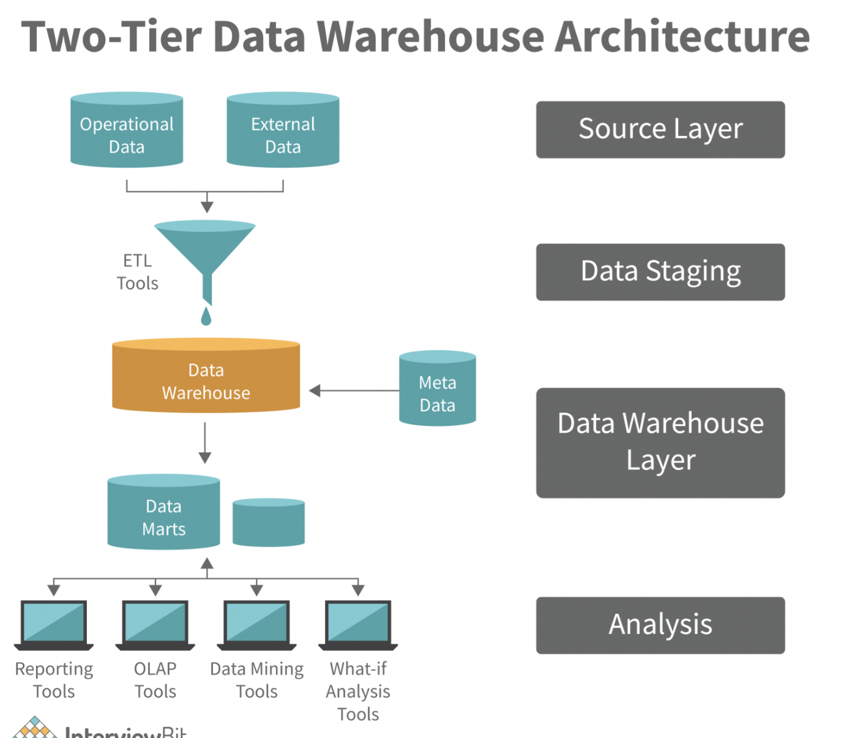
New Database Applications And Architectures
Two-tire-Architecture
Four-stage data flow in which physical sources are separated from data warehouses by a two-layered architecture.
ELT: Extract, Transform and Load

Slide 96
New Database Applications And Architectures
Three-tire-Architecture
Employed in the source layer, the reconciled layer, and the data warehouse layer.
The reconciled layer sits between the source data and data warehouse.
The main disadvantage of the reconciled layer is the fact that it is not possible to completely ignore the problems of the data before it is reconciled.
Therefore, the main focus of the reconciler should be on data integrity, accuracy, and consistency.

Slide 97
New Database Applications And Architectures
2. Multimedia Database
A Multimedia database (MMDB) is a collection of related multimedia data, which include one or more primary media data types such as text , images, graphic objects (including drawings, sketches and illustrations) animation sequences, audio and video

Slide 98
New Database Applications And Architectures
Content of MMDBMS
A Multimedia Database (MMDB) hosts one or more multimedia data types . These data types are broadly categorised into three classes:
» Static Media
Time independent, constant, non interactive e.g. image and graphic object.
» Dynamic Media
Time dependent, moving, interactive, e.g. Audio , video and animation.
» Dimensional Media
3D game and computer aided drafting programs). E.g. virtual reality, 9-D movies.

Slide 99
New Database Applications And Architectures
Components Of Multimedia System
Categorised as ‘live’ or ‘orchestrated’ Live applications involve interaction among users. Eg. Video Conferencing Orchestrated applications reproduces the data that was previously generated and stored in some medium. Eg. Pay per view movies. In order to satisfy the requirements of these categories various Multimedia Architectures are used.

Slide 100
New Database Applications And Architectures
Conti…
Multimedia systems can either be standalone , server or networked.
Standalone Multimedia System
Consist of storage subsystem , which is a database and storage devices where media content resides.
Server Multimedia System
consist of both storage subsystem and networked subsystem in levels.
Networked Multimedia System
Consist of both networked subsystem.

Slide 101
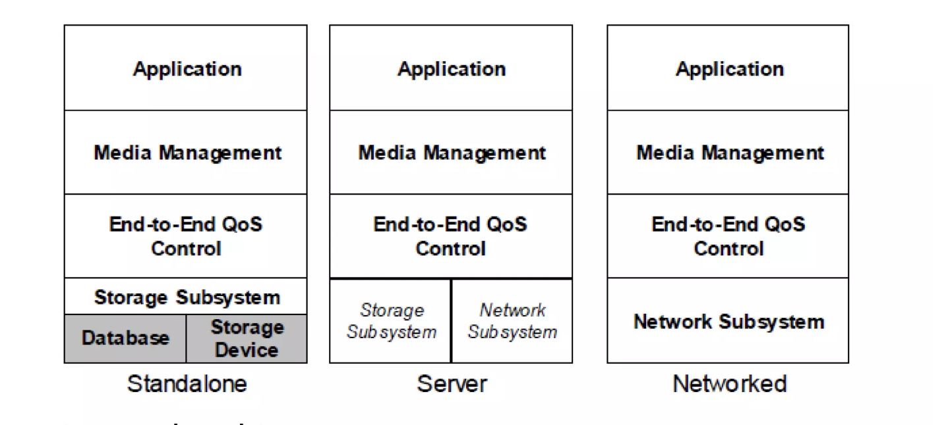
Multimedia Architecture
Lowered Layer Provide Functionality to Upper layer

Slide 102
Multimedia Architecture
Storage Subsystem and Network Subsystem (Layer 1)
These services are central to multimedia system and is normally part of OS services.
End-To-End QoS (Layer 2)
For Standalone system :
Source -> multimedia database For
Source -> multimedia server
This layer deals with maintaining connection between source of the multimedia content and the destination.
Networked system :
QoS (Quality of Service) comprises of delay, jitter, and packet loss probability.

Slide 103
Multimedia Architecture
Media Management (Layer 3)
It provides general services like media synchronisation and media stream management .
Application Layer (Layer 4)
Interface with the user, to provide access and control to the presentation.
It ensures temporal and spatial relationships between media streams.

Slide 104

Architecture For OODBMS.
Object Model
That will act as the logical model for all OODBMS and provide a level of interoperability.
Data Definition Language (ODL).
A concrete specification of the operations permitted over a schema defined in the data model.
Query Language (OQL).
For posing ad-hoc queries but not for data definition or data manipulation.
Language Bindings To Existing OOPL (C++, Java, Smalltalk).
Object manipulation languages are the integration of a PL with the ODMG model.
So the OOPL’s get persistence and the gets a flexible and standard DB programming language.

Slide 105
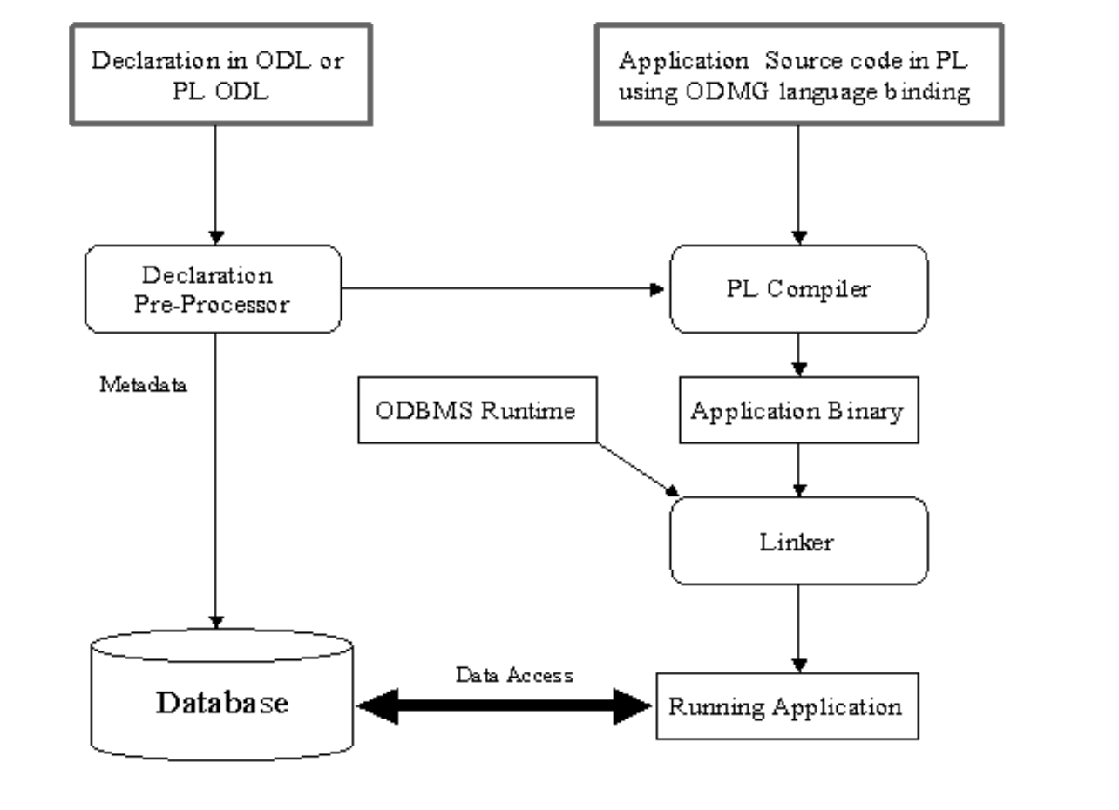
Architecture For OODBMS.

Slide 106
Object Model
1. Data Model Object identity
State and structure of data Complex objects
2. Behavior model
Dynamics of the data
Operations of the data
3. Persistence model
The way the persistent and transient data is created & changes status
4. Naming model
naming and accessing objects
Object identity
Complex objects
Late binding/overriding
Extensibility
Completeness
Type and classes
Inheritance hierarchies
Encapsulation

Slide 107
Recap and Video Link
Advanced Data Types
Deductive database,
Temporal database,
Constraint in database,
Database and XML,
New database applications and architectures:
Video Link: https://www.youtube.com/watch?v=ZI5ETxJhWxk

Slide 108
MCQ
ODL supports which of the following types of association relationships?
A. Unary
B. Unary and Binary
C. Unary and Binary and Ternary
D. Unary and Binary and Ternary and higher
2.
An extent is which of the following?
A. A keyword that indicates that the subclass inherits from a superclass
B. A keyword that indicates that the superclass inherits from a subclass
C. The set of all instances of a class within a database
D. Only one instance of a class within a database
3.

Slide 109
MCQ
Identify the class name for the following code: ABC123 course();
A. ABC123
B. course
C. course()
D. All of the above.
4.
Using ODL, you can define which of the following?
A. Attribute
B. Structure
C. Operation
D. All of the above.
5.
The keyword "inverse" is used in which of the following?
A. Class
B. Attribute
C. Relationship
D. All of the above.

Slide 110
Thank You

